Slide 1
Harriott’s¹ Model for Overdamped Systems
ME
Universitas Pertamina
2020
¹Harriott, P., Process control, McGraw‐Hill, New York (1964)

Slide 2
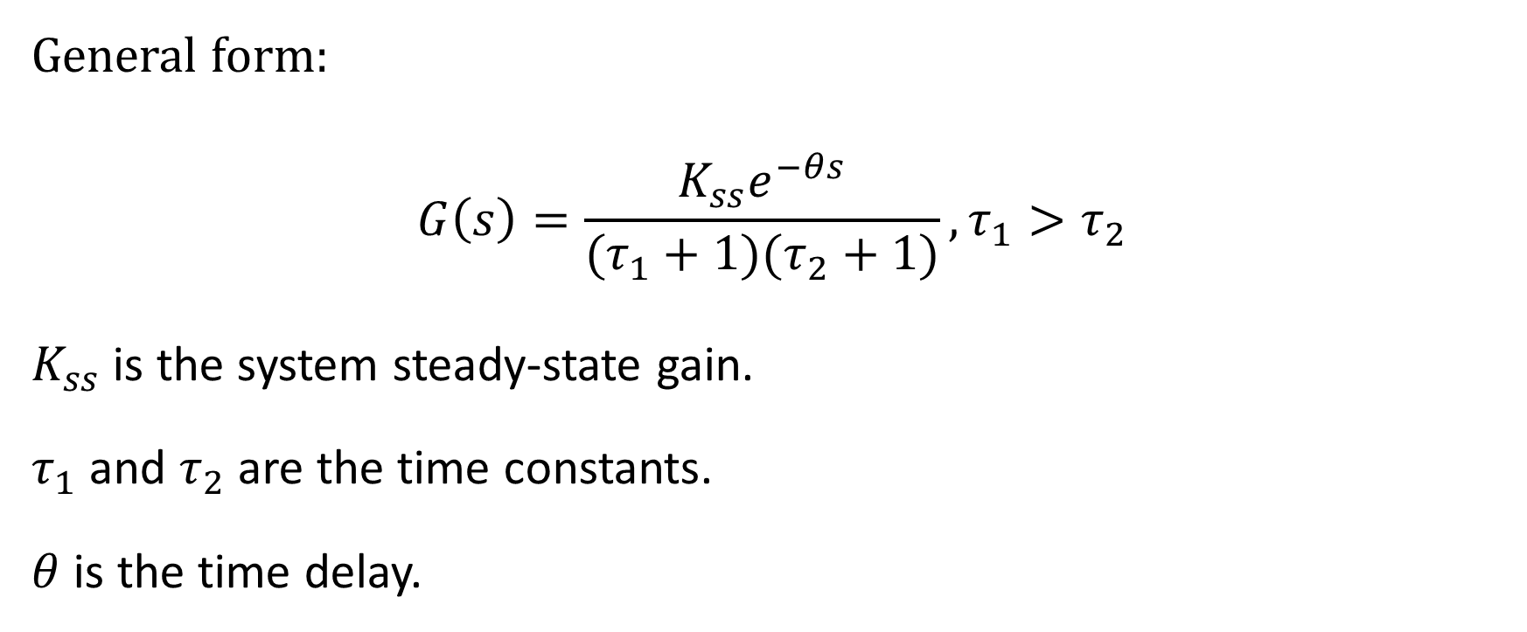
Overdamped Second Order System
General form:
$$G\left(s\right)=\frac{K_{ss}e^{−θs}}{(τ_{1}+1)(τ_{2}+1)}, τ_{1}>τ_{2}$$
$K_{ss}$ is the system steady-state gain.
$τ_{1}$ and $τ_{2}$ are the time constants.
$θ$ is the time delay.

Slide 3







The acquired step response:
$$y_{ss}$$
$$y_{72}$$
$$y_{z}$$
Remove the offset
$$θ$$
$$t_{z}$$
$$t_{72}$$
$$K_{ss}=\frac{y_{ss}}{\text{Amplitude} \text{of} \text{the} \text{step} \text{input}}$$

Slide 4
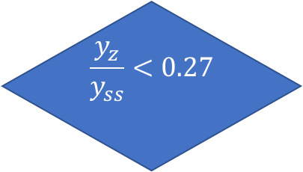

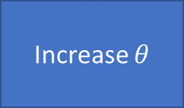
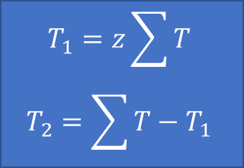
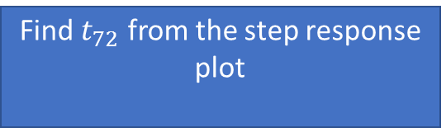
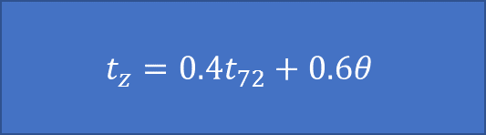



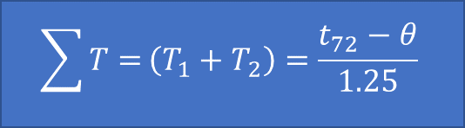
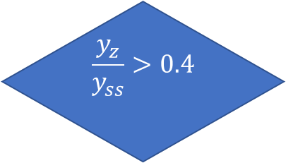
Remove the offset
Estimate $θ, y_{ss}, K_{ss}$
Find $t_{72}$ from the step response plot
Find $y_{z}$
$$t_{z}=0.4t_{72}+0.6θ$$
$$\sum{T=}\left(T_{1}+T_{2}\right)=\frac{t_{72}−θ}{1.25}$$
$$\frac{y_{z}}{y_{ss}}<0.27$$
yes
Increase $θ$
no
$$T_{1}=z\sum{T}$$
$$T_{2}=\sum{T}−T_{1}$$
$$\frac{y_{z}}{y_{ss}}>0.4$$
yes
Decrease $θ$
no
Find $z$ from the Hariot’s plot

Slide 5
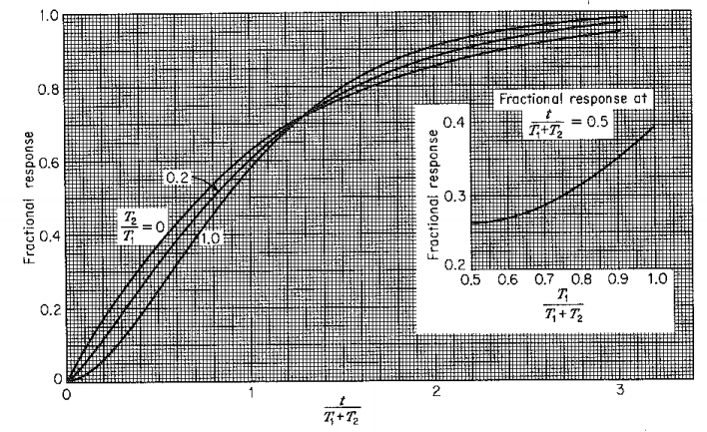

Slide 6
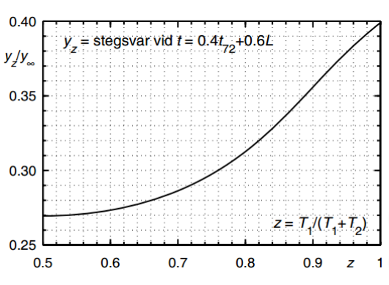
http://www.users.abo.fi/khaggblo/PDC/PDC5milver.pdf

